Slide 1
Please click on the “slide show” tab on the top bar and “From Beginning” tab to start the Activity

Slide 2
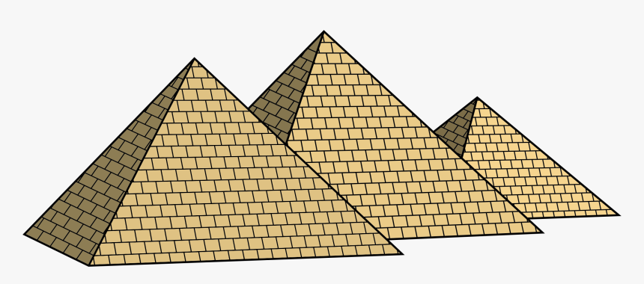
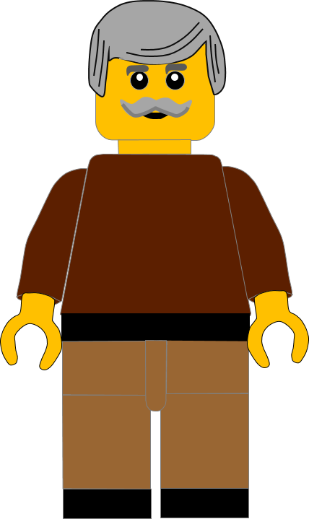
In this activity you will be given 10 questions about the story of Moses and the 10 plagues of Egypt, which you can find in Exodus 4 -12.
You will be given 3 possible answers to each question and you have to choose the right one.
Click here to start the quiz

Slide 3
Question 1:
Moses went to Pharaoh with ?
Miriam
Aaron
Jethro
Press your answer

Slide 4
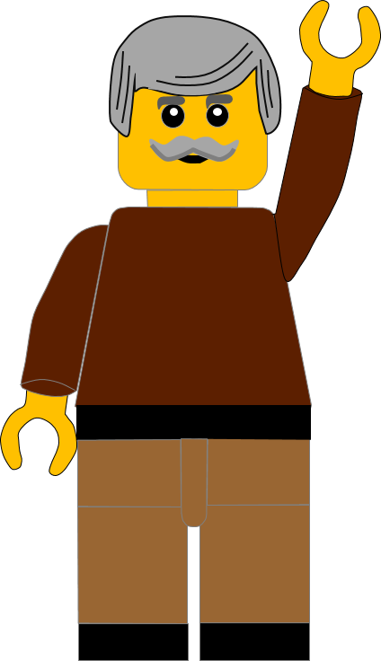
Question 1:
Moses went to Pharaoh with ?
Miriam
Aaron
Jethro
You are right.
Moses went with his brother Aaron.
Well Done
Click for the next question

Slide 5
Question 2:
What sign did Moses show Pharaoh, to confirm God had sent him?
Changed water to wine
Changed stick to a snake
Changed bread into fish
Press your answer

Slide 6
Question 2:
What sign did Moses show Pharaoh, to confirm God had sent him?
Changed water into wine
Changed stick into snake
Changed bread into fish
You are right.
When the stick was thrown on the ground it changed into a snake.
Well Done
Click for the next question

Slide 7
Question 3:
Pharaoh was angry and . . .?
Sent Moses away
Killed Moses
Put Moses in prison
Press your answer

Slide 8
Question 3:
Pharaoh was angry and . . .?
Sent Moses away
Killed Moses
Put Moses in prison
You are right.
Pharaoh sent Moses and Aaron away.
Well Done
Click for the next question

Slide 9
Question 4:
The first plague God sent on Egypt was?
Locusts ate the food
Frogs appeared
River turned to blood
Press your answer

Slide 10
Question 4:
The first plague God sent on Egypt was?
Locusts ate the food
Frogs appeared
River turned to blood
You are right.
When Aaron struck the river with his stick the water turned to blood.
Well Done
Click for the next question

Slide 11
Question 5:
Which of these insects did God not send as a plague on Egypt?
Ants
Gnats
Locusts
Press your answer

Slide 12
Question 5:
Which of these insects did God not send as a plague on Egypt?
Ants
Gnats
Locusts
You are right.
God sent Gnats and Locusts but he didn’t send ants
Well Done
Click for the next question

Slide 13
Question 6:
Which of these creatures did God send as a plague on Egypt
Spiders
Snakes
Frogs
Press your answer

Slide 14
Question 6:
Which of these creatures did God send as a plague on Egypt
Spiders
Snakes
Frogs
You are correct.
God didn’t send snakes or spiders, but he did send frogs.
Well Done
Click for the next question

Slide 15
Question 7:
Which plague killed the farm animals?
Darkness
Disease
Hail
Press your answer

Slide 16
Question 7:
Which plague killed the farm animals?
Darkness
Disease
Hail
You are right.
Some of the animals were killed by hail but most were killed by disease
Well Done
Click for the next question

Slide 17
Question 8:
Why did Pharaoh not listen to God? (Exodus 7v14)
He was stubborn
He was deaf
He had gone away
Press your answer

Slide 18
Question 8:
Why did Pharaoh not listen to God? (Exodus 7v14)
He was stubborn
He was deaf
He had gone away
You are right.
Pharaoh was stubborn and didn’t believe God
Well Done
Click for the next question

Slide 19
Question 9:
What was the final plague?
Locusts
Darkness
Death of firstborn
Press your answer

Slide 20
Question 9:
What was the final plague?
Locusts
Darkness
Death of firstborn
You are right.
The final plague was the death of every family’s firstborn son.
Well Done
Click for the next question

Slide 21
Question 10:
What made Pharaoh change his mind and let the Israelites go free?
His son died
Moses paid Him money
His wife died
Press your answer

Slide 22
Question 10:
What made Pharaoh change his mind and let the Israelites go free?
His son died
Moses paid him money
His wife died
You are right.
Pharaoh changed his mind because his oldest son died
Well Done
Click for the next slide

Slide 23
Well done for finishing the quiz.
I’ll have another one for you next week.
See you next time

Slide 24
Whoops!
That’s not quite right.
Try again.
Click to return to the quiz

