Slide 1
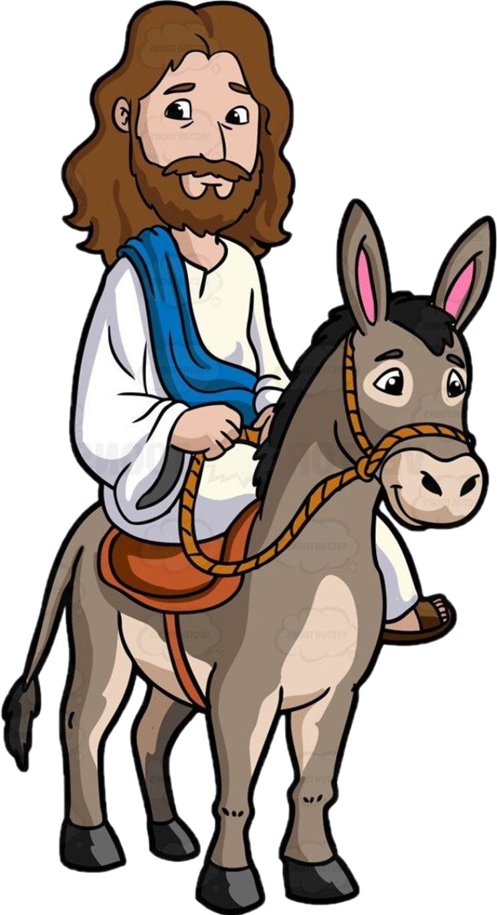
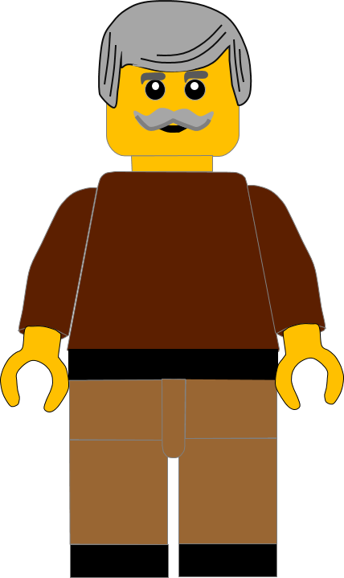
In this activity you will be given 10 questions about the story of Jesus entering Jerusalem in
Matthew chapter 21 v 1 -11.
You will be given 3 possible answers to each question and you have to choose the right one.
Click here to start the quiz

Slide 2
Question 1:
Why was Jesus going to Jerusalem?
To celebrate Passover
To celebrate Christmas
To visit the Temple
Press your answer

Slide 3
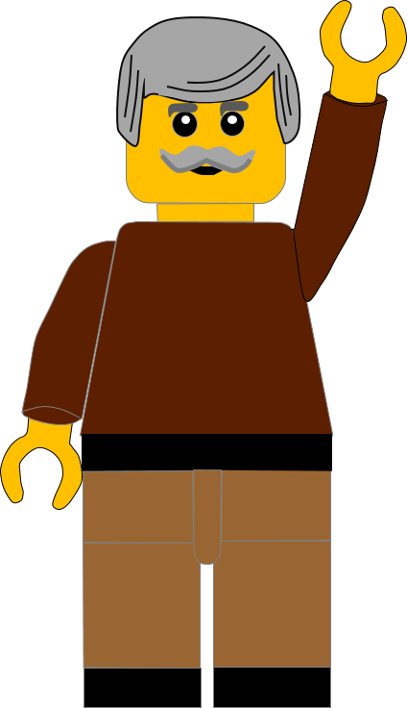
Question 1:
Why was Jesus going to Jerusalem?
To celebrate Passover
To celebrate Christmas
To visit the Temple
Fantastic answer.
Jesus went to Jerusalem to celebrate PASSOVER.
Well Done
Click for the next question

Slide 4
Question 2:
What was the name of the town Jesus stopped at before entering Jerusalem?
Bethlehem
Bethphage
Nazareth
Press your answer

Slide 5
Question 2:
What was the name of the town Jesus stopped at before entering Jerusalem?
Bethlehem
Bethphage
Nazareth
You are right.
Jesus stopped at BETHPHAGE, before entering Jerusalem
Well Done
Click for the next question

Slide 6
Question 3:
What was the name of the Mount near Bethphage?
Olives
Grapes
Bananas
Press your answer

Slide 7
Question 3:
What was the name of the Mount near Bethphage?
Olives
Grapes
Bananas
You are correct.
Bethphage is near the Mount of OLIVES.
Well Done
Click for the next question

Slide 8
Question 4:
How many disciples did Jesus send into Jerusalem?
Two
Three
Four
Press your answer

Slide 9
Question 4:
How many disciples did Jesus send into Jerusalem?
Two
Three
Four
Fantastic answer.
Jesus sent TWO, disciples into Jerusalem.
Well Done
Click for the next question

Slide 10
Question 5:
What did Jesus tell the disciples to fetch?
Horse
Donkey
Sheep
Press your answer

Slide 11
Question 5:
What did Jesus tell the disciples to fetch?
Horse
Donkey
Sheep
Great answer.
Jesus told the disciples to fetch a DONKEY.
Well Done
Click for the next question

Slide 12
Question 6:
Who had told the people that
“their King would come riding on a donkey”?
Romans
Priests
Prophets
Press your answer

Slide 13
Question 6:
Who had told the people that
“their King would come riding on a donkey”?
Romans
Priests
Prophets
You are correct.
The PROPHETS Isaiah and Zechariah said that the king would come riding on a donkey.
Well Done
Click for the next question

Slide 14
Question 7:
What did the disciples put on the donkey?
Saddle
Coats
Blankets
Press your answer

Slide 15
Question 7:
What did the disciples put on the donkey?
Saddle
Coats
Blankets
You are right.
The disciples put their COATS onto the donkey.
Well Done
Click for the next question

Slide 16
Question 8:
What did the people put on the road in front of Jesus?
Coats and brushes
Coats and bushes
Coats and branches
Press your answer

Slide 17
Question 8:
What did the people put on the road in front of Jesus?
Coats and brushes
Coats and bushes
Coats and branches
Spot on answer.
The people laid their COATS AND BRANCHES on the road in front of Jesus.
Well Done
Click for the next question

Slide 18
Question 9:
Who did the people say Jesus was the son of?
Moses
Abraham
David
Press your answer

Slide 19
Question 9:
Who did the people say Jesus was the son of?
Moses
Abraham
David
Great answer.
The people were calling Jesus the SON OF DAVID. This was a name for God’s saviour.
Well Done.
Click for the next question

Slide 20
Question 10:
Whose name did the people say Jesus was coming in?
King
Lord
Emperor
Press your answer

Slide 21
Question 10:
Whose name did the people say Jesus was coming in?
King
Lord
Emperor
That’s the right answer.
The people said Jesus had come
“in the name of the LORD.”
Well Done
Click for the next question

Slide 22
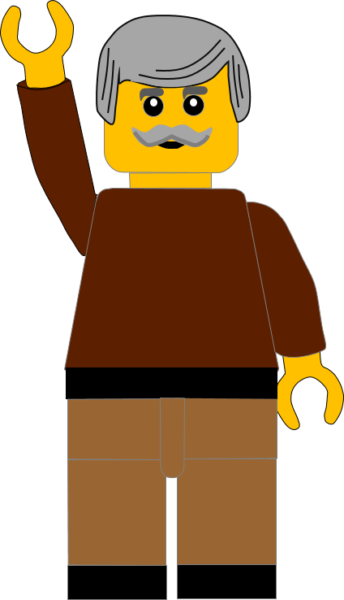
Well done for finishing the quiz.
I’ll have another one for you next week.
See you next time

Slide 23
Whoops!
That’s not quite right.
Try again.
Click to return to the quiz

