Slide 1
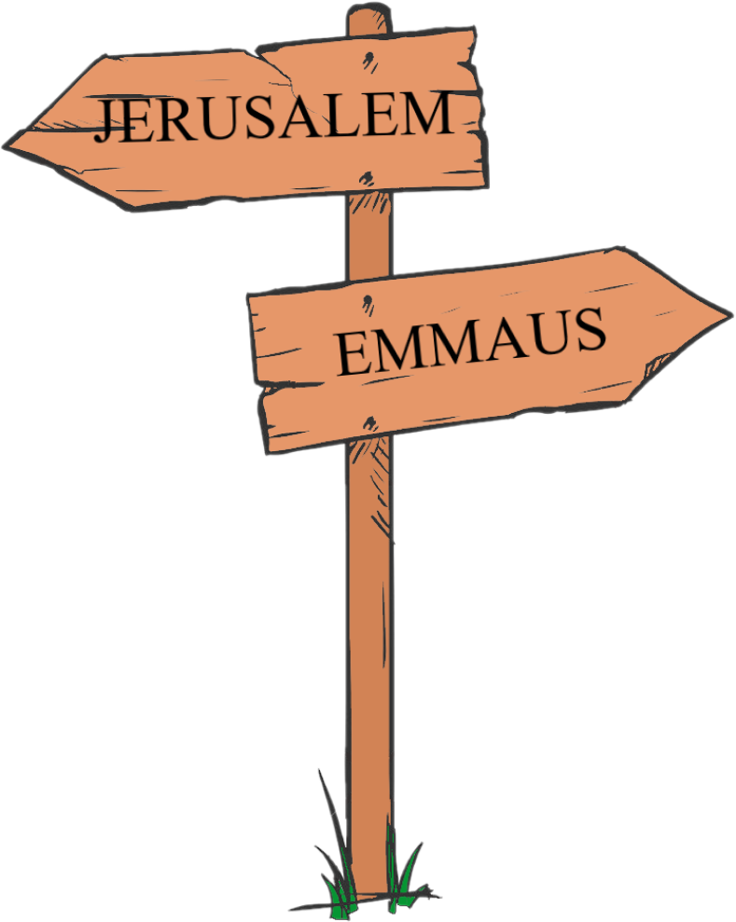
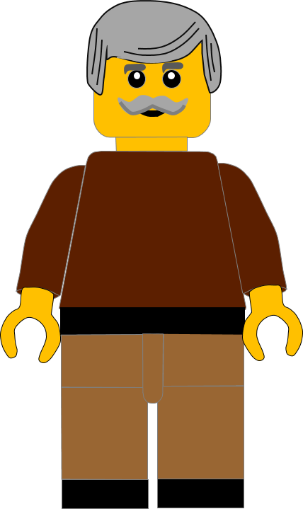
In this activity you will be given 10 questions about the story of The road to Emmaus in
Luke chapter 24 v 13 - 35.
You will be given 3 possible answers to each question and you have to choose the right one.
Click here to start the quiz

Slide 2
Question 1:
From which place had the disciples come from?
Jericho
Bethany
Jerusalem
Press your answer

Slide 3
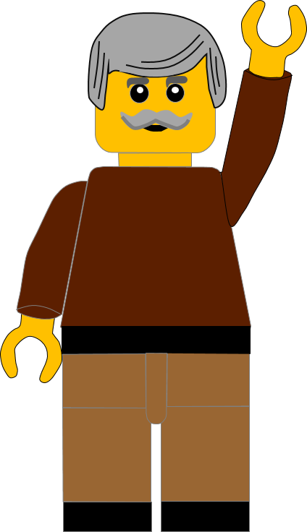
Question 1:
From which place had the disciples come from?
Jericho
Bethany
Jerusalem
You are correct.
The disciples had left JERUSALEM and were going to Emmaus
Well Done
Click for the next question

Slide 4
Question 2:
How far away was Emmaus from Jerusalem?
Six miles
Seven miles
Eight miles
Press your answer

Slide 5
Question 2:
How far away was Emmaus from Jerusalem?
Six miles
Seven miles
Eight miles
You are right.
It is about SEVEN MILES from Jerusalem to Emmaus.
Well Done
Click for the next question

Slide 6
Question 3:
What was the name of one of the disciples?
Cleopas
Daniel
Ephraim
Press your answer

Slide 7
Question 3:
What was the name of one of the disciples?
Cleopas
Daniel
Ephraim
Fantastic answer.
One of the men was called CLEOPAS, we’re not told the name of the other disciple.
Well Done
Click for the next question

Slide 8
Question 4:
Who joined the disciples on their walk?
John
James
Jesus
Press your answer

Slide 9
Question 4:
Who joined the disciples on their walk?
John
James
Jesus
Fantastic answer.
JESUS joined the men on their walk.
Well Done
Click for the next question

Slide 10
Question 5:
What were the men talking about on their walk?
The death of Jesus
The football scores
Where to go next
Press your answer

Slide 11
Question 5:
What were the men talking about on their walk?
The death of Jesus
The football scores
Where to go next
Great answer.
The men were talking about the DEATH OF JESUS.
Well Done
Click for the next question

Slide 12
Question 6:
What did the women tell the disciples?
Jesus’ tomb was sealed tightly
The soldiers had moved Jesus
Jesus’ tomb was empty
Press your answer

Slide 13
Question 6:
What did the women tell the disciples?
Jesus’ tomb was sealed tightly
The soldiers had moved Jesus
Jesus’ tomb was empty
You are correct.
The women had told the disciples that
JESUS’ TOMB WAS EMPTY.
Well Done
Click for the next question

Slide 14
Question 7:
Jesus explained to the disciples what the scriptures said about Him, starting with who?
Abraham
Moses
Noah
Press your answer

Slide 15
Question 7:
Jesus explained to the disciples what the scriptures said about Him, starting with who?
Abraham
Moses
Noah
You are right.
Jesus explained what the scriptures said about Him starting with the words of MOSES.
Well Done
Click for the next question

Slide 16
Question 8:
When they arrived at Emmaus, what did the disciples ask Jesus?
Was he returning to Jerusalem
Did he need food for his journey
Stay with them for the night
Press your answer

Slide 17
Question 8:
When they arrived at Emmaus, what did the disciples ask Jesus?
Was he returning to Jerusalem
Did he need food for his journey
Stay with them for the night
Spot on answer.
They asked Jesus to STAY WITH THEM FOR THE NIGHT as it was late.
Well Done
Click for the next question

Slide 18
Question 9:
What did Jesus do that showed the disciples who He was ?
Healed the men
Divided the bread
Forgave the men
Press your answer

Slide 19
Question 9:
What did Jesus do that showed the disciples who He was ?
Healed the men
Divided the bread
Forgave the men
Great answer.
The men recognized Jesus when He DIVIDED THE BREAD.
Well Done.
Click for the next question

Slide 20
Question 10:
Where did the disciples say it was like when Jesus was talking to them?
A fountain washing us
A medicine healing us
A fire burning in us
Press your answer

Slide 21
Question 10:
Where did the disciples say it was like when Jesus was talking to them?
A fountain washing us
A medicine healing us
A fire burning in us
That’s the right answer.
The disciples said that it was like A FIRE BURNING IN US when Jesus spoke to us.
Well Done
Click for the next question

Slide 22
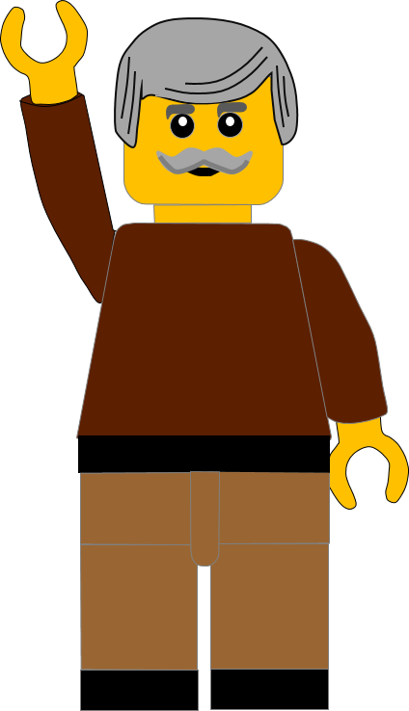
Well done for finishing the quiz.
I’ll have another one for you next week.
See you next time

Slide 23
Whoops!
That’s not quite right.
Try again.
Click to return to the quiz

