Slide 1
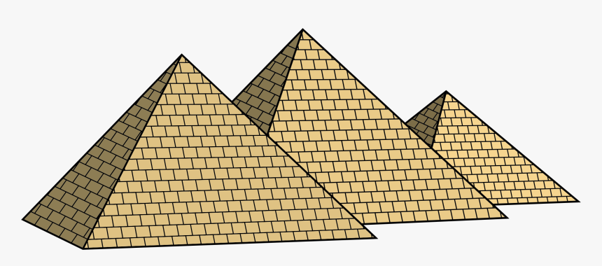
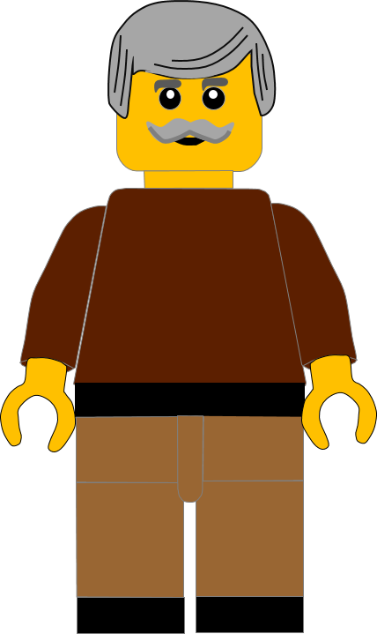
In this activity you will be given 10 questions about the story of baby Moses, which you can find in Exodus 1v8 – 2v9.
You will be given 3 possible answers to each question and you have to choose the right one.
Click here to start the quiz

Slide 2
Question 1:
Moses was born in …………?
Egypt
England
Israel
Press your answer

Slide 3
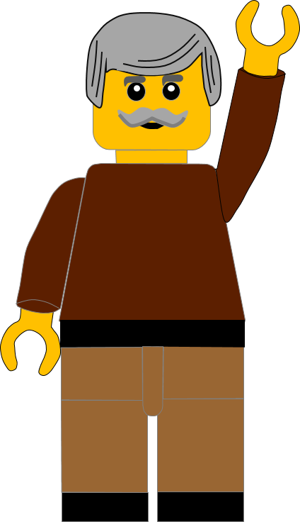
Question 1:
Moses was born in …………?
Egypt
England
Israel
You are right.
Moses was born in Egypt.
Well Done
Click for the next question

Slide 4
Question 2:
Which Hebrew family were Moses’ parents in?
Joseph
Judah
Levi
Press your answer

Slide 5
Question 2:
Which Hebrew family were Moses’ parents in?
Joseph
Judah
Levi
You are right.
Moses’ parents were in the family of Levi.
Well Done
Click for the next question

Slide 6
Question 3:
What had the Egyptian king (Pharoah) made the Hebrews?
Slaves
Gardeners
Teachers
Press your answer

Slide 7
Question 3:
What had the Egyptian king (Pharoah) made the Hebrews?
Slaves
Gardeners
Teachers
You are right.
Pharoah made the Hebrews into slaves.
Well Done
Click for the next question

Slide 8
Question 4:
What did Pharoah tell his soldiers to do?
Kill the Hebrew baby girls
Kill the Hebrew baby boys
Knock down Hebrew houses
Press your answer

Slide 9
Question 4:
What did Pharoah tell his soldiers to do?
Kill the Hebrew baby girls
Kill the Hebrew baby boys
Knock down Hebrew houses
You are right.
Pharoah told his soldiers to kill the Hebrew baby boys.
Well Done
Click for the next question

Slide 10
Question 5:
How long did Moses’ mother hide him in her house?
2 months
3 months
4 months
Press your answer

Slide 11
Question 5:
How long did Moses’ mother hide him in her house?
2 months
3 months
4 months
You are right.
Moses’ mother tried to hide him for 3 months.
Well Done
Click for the next question

Slide 12
Question 6:
What did Moses’ mother make to hide him in?
A secret room
Egyptian clothes
A basket
Press your answer

Slide 13
Question 6:
What did Moses’ mother make to hide him in?
A secret room
Egyptian clothes
A basket
You are right.
Moses’ mother made a basket to hide him in.
Well Done
Click for the next question

Slide 14
Question 7:
Where did Moses’ mother put the basket to hide him?
In the tall grass
Down the well
Under the table
Press your answer

Slide 15
Question 7:
Where did Moses’ mother put the basket to hide him?
In the tall grass
Down the well
Under the table
You are right.
Moses’ mother hid the basket in the tall grass by the river.
Well Done
Click for the next question

Slide 16
Question 8:
Who stayed to watch the basket?
His sister
His brother
His mother
Press your answer

Slide 17
Question 8:
Who stayed to watch the basket?
His sister
His brother
His mother
You are right.
Moses’ sister Miriam stayed to watch the basket.
Well Done
Click for the next question

Slide 18
Question 9:
Who found the basket in the River?
Pharoah
Princess
Priest
Press your answer

Slide 19
Question 9:
Who found the basket in the River?
Pharoah
Princess
Priest
You are right.
The Egyptian Princess found the basket in the reeds.
Well Done
Click for the next question

Slide 20
Question 10:
What did the Princess do when she found the baby?
Left him in the basket
Threw him in the river
Looked for a nurse
Press your answer

Slide 21
Question 10:
What did the Princess do when she found the baby?
Left him in the basket
Threw him in the river
Looked for a nurse
You are right.
The Princess felt sorry for the baby and looked for a nurse.
Well Done
Click for the next slide

Slide 22
Well done for finishing the quiz.
I’ll have another one for you next week.
See you next time

Slide 23
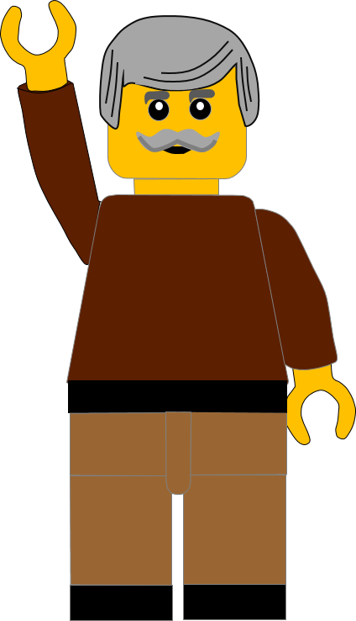
Whoops!
That’s not quite right.
Try again.
Click to return to the quiz

