Slide 1
Please click on the “slide show” tab on the top bar and “From Beginning” tab to start the Activity

Slide 2
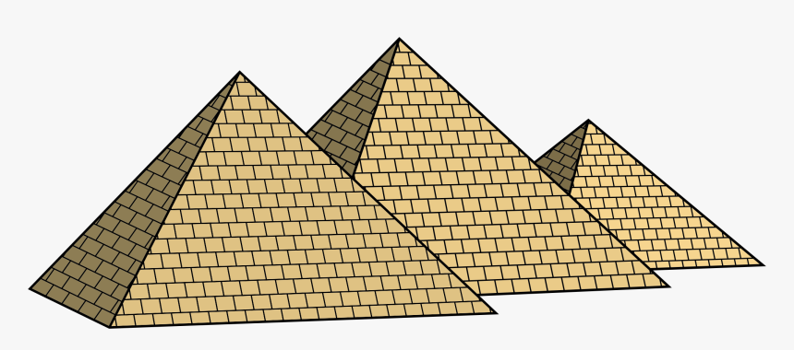
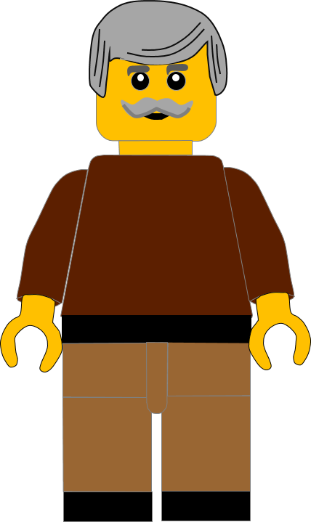
In this activity you will be given 10 questions about the story of Moses and the 5th commandment which you can find in Exodus 20 v12.
You will be given 3 possible answers to each question and you have to choose the right one.
Click here to start the quiz

Slide 3
Question 1:
What did Moses tell the Israelites to do to their parents?
Help them
Hug them
Honour them
Press your answer

Slide 4
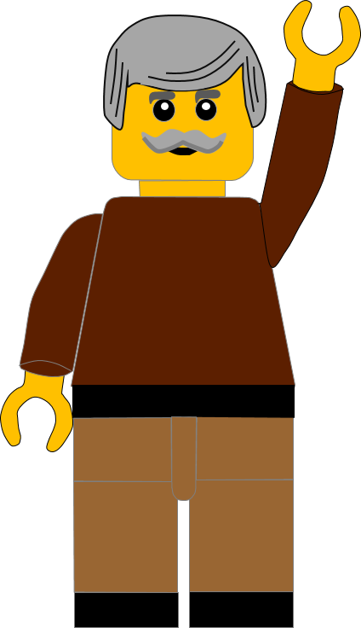
Question 1:
What did Moses tell the Israelites to do to their parents?
Help them
Hug them
Honour them
You are right.
Moses told them they should HONOUR their parents.
Well Done
Click for the next question

Slide 5
Question 2:
When God gave Moses the Ten Commandments where was Moses?
In the desert
On Mount Sinai
In Egypt
Press your answer

Slide 6
Question 2:
When God gave Moses the Ten Commandments where was Moses?
In the desert
On Mount Sinai
In Egypt
That’s the right answer.
God gave Moses the Commandments on
MOUNT SINAI
Well Done
Click for the next question

Slide 7
Question 3:
What do we call the stories Jesus told to help us understand His teaching?
Parables
Proverbs
Psalms
Press your answer

Slide 8
Question 3:
What do we call the stories Jesus told to help us understand His teaching?
Parables
Proverbs
Psalms
That’s correct.
The stories Jesus told are called PARABLES
Well Done
Click for the next question

Slide 9
Question 4:
In today’s story where did the Father ask his sons to work?
In the Vineyard
In the Kitchen
In the farmyard
Press your answer

Slide 10
Question 4:
In today’s story where did the Father ask his sons to work?
In the Vineyard
In the Kitchen
In the farmyard
You are right.
The father asked them to work in the VINEYARD.
Well Done
Click for the next question

Slide 11
Question 5:
What type of fruit grows in a vineyard?
Apples
Oranges
Grapes
Press your answer

Slide 12
Question 5:
What type of fruit grows in a vineyard?
Apples
Oranges
Grapes
Great answer.
GRAPES grow in vineyards.
Well Done
Click for the next question

Slide 13
Question 6:
Which son said he wouldn’t do what his father asked?
First Son
Second Son
Both Sons
Press your answer

Slide 14
Question 6:
Which son said he wouldn’t do what his father asked?
First Son
Second Son
Both Sons
Good answer.
The FIRST SON said he wouldn’t do what his father asked.
Well Done
Click for the next question

Slide 15
Question 7:
Which son said he would do what his father asked?
First Son
Second Son
Both Sons
Press your answer

Slide 16
Question 7:
Which son said he would do what his father asked?
First Son
Second Son
Both Sons
You’re right.
The SECOND SON said he would do what his father asked.
Well Done
Click for the next question

Slide 17
Question 8:
Which son changed his mind and did what his father asked?
First Son
Second Son
Both Sons
Press your answer

Slide 18
Question 8:
Which son changed his mind and did what his father asked?
First Son
Second Son
Both Sons
That’s right.
The FIRST SON changed his mind and did what his father asked.
Well Done
Click for the next question

Slide 19
Question 9:
In this Parable, which people was Jesus mainly talking to?
The Princes
The Prophets
The Pharisees
Press your answer

Slide 20
Question 9:
In this Parable, which people was Jesus mainly talking to?
The Princes
The Prophets
The Pharisees
Fantastic answer.
Jesus was talking to
the PHARISEES.
Well Done
Click for the next question

Slide 21
Question 10:
Which of the two sons obeyed their father?
First Son
Second Son
Neither Sons
Press your answer

Slide 22
Question 10:
Which of the two sons obeyed their father?
First Son
Second Son
Neither Son
Correct answer.
The FIRST SON changed his mind and obeyed his father.
Well Done
Click for the next question

Slide 23
Well done for finishing the quiz.
I’ll have another one for you next week.
See you next time

Slide 24
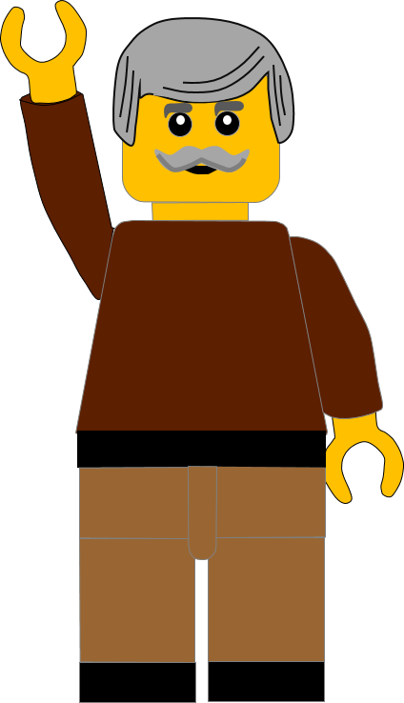
Whoops!
That’s not quite right.
Try again.
Click to return to the quiz

