Slide 1
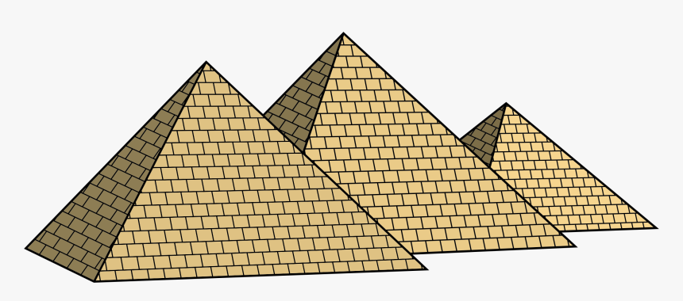
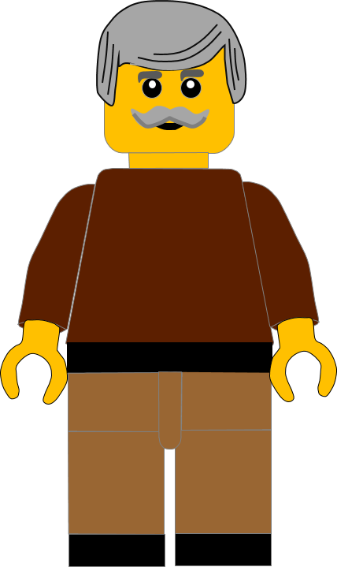
In this activity you will be given 10 questions about the story of Moses running away, which you can find in Exodus 2 v11 – 24.
You will be given 3 possible answers to each question and you have to choose the right one.
Click here to start the quiz

Slide 2
Question 1:
Moses grew up in which country?
Midian
Egypt
Judah
Press your answer

Slide 3
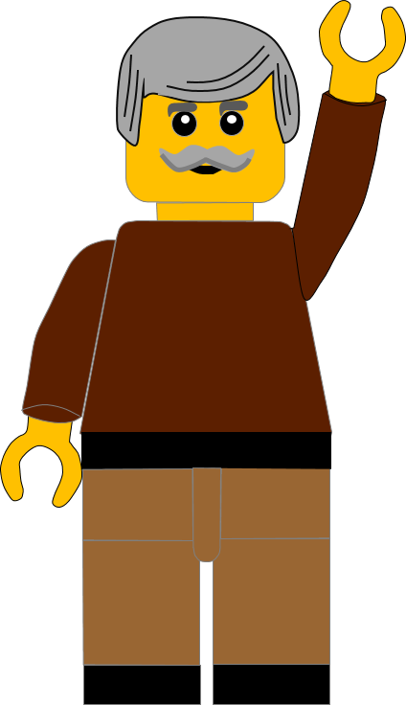
Question 1:
Moses grew up in which country?
Midian
Egypt
Judah
You are right.
Moses grew up in Egypt.
Well Done
Click for the next question

Slide 4
Question 2:
What did Moses do wrong that made Pharaoh angry?
Killed an Egyptian
Stole the jewels
Broke the statue
Press your answer

Slide 5
Question 2:
What did Moses do wrong that made Pharaoh angry?
Killed an Egyptian
Stole the jewels
Broke the statue
You are right.
Moses killed an Egyptian.
Well Done
Click for the next question

Slide 6
Question 3:
Where did Moses try to hide the Egyptian?
Down the well
In the cupboard
In the sand
Press your answer

Slide 7
Question 3:
Where did Moses try to hide the Egyptian?
Down the well
In the cupboard
In the sand
You are right.
Moses tried to hide the Egyptian’s body in the sand.
Well Done
Click for the next question

Slide 8
Question 4:
What was the Egyptian doing?
Hurting a Hebrew slave
Attacking the Pharaoh
Calling Moses names
Press your answer

Slide 9
Question 4:
What was the Egyptian doing?
Hurting a Hebrew slave
Attacking the Pharaoh
Calling Moses names
You are right.
The Egyptian was beating the Hebrew slave.
Well Done
Click for the next question

Slide 10
Question 5:
Who said to Moses: “Who made you ruler and judge over us?”
Pharaoh
An Egyptian
A Hebrew
Press your answer

Slide 11
Question 5:
Who said to Moses: “Who made you ruler and judge over us?”
Pharaoh
An Egyptian
A Hebrew
You are correct.
A Hebrew fighting with another Hebrew asked Moses this question.
Well Done
Click for the next question

Slide 12
Question 6:
What did Moses do after the Hebrew asked him this question?
Told Pharaoh
Ran away
Killed the Hebrew
Press your answer

Slide 13
Question 6:
What did Moses do after the Hebrew asked him this question?
Told Pharaoh
Ran away
Killed the Hebrew
You are right.
Moses was afraid and ran away.
Well Done
Click for the next question

Slide 14
Question 7:
Where did Moses run away to?
Midian
To his mother
Israel
Press your answer

Slide 15
Question 7:
Where did Moses run away to?
Midian
To his mother
Israel
You are right.
Moses ran away across the desert to Midian.
Well Done
Click for the next question

Slide 16
Question 8:
Where did Moses meet the seven sisters?
In the market
By the well
Under the trees
Press your answer

Slide 17
Question 8:
Where did Moses meet the seven sisters?
In the market
By the well
Under the trees
You are right.
Moses met the seven sisters by the well.
Well Done
Click for the next question

Slide 18
Question 9:
What were the sisters doing by the well?
Getting bread
Getting sheep
Getting water
Press your answer

Slide 19
Question 9:
What were the sisters doing by the well?
Getting bread
Getting sheep
Getting water
You are right.
The sisters were getting water, but the shepherds stopped them.
Well Done
Click for the next question

Slide 20
Question 10:
What did Moses do after he chased away the shepherds?
Married Zipporah
Adopted Zipporah
Chased away Zipporah
Press your answer

Slide 21
Question 10:
What did Moses do after he chased away the shepherds?
Married Zipporah
Adopted Zipporah
Chased Zipporah away
You are right.
Moses and Zipporah were married.
Well Done
Click for the next slide

Slide 22
Well done for finishing the quiz.
I’ll have another one for you next week.
See you next time

Slide 23
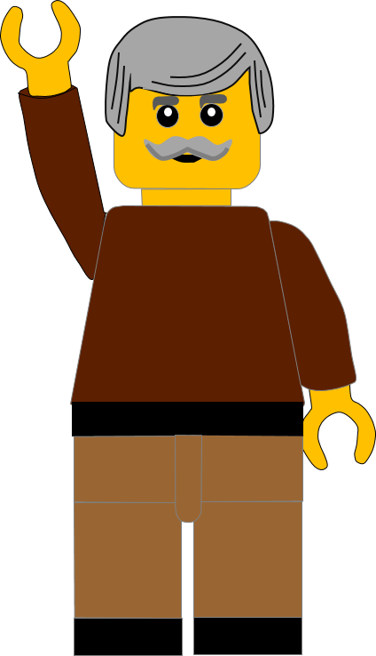
Whoops!
That’s not quite right.
Try again.
Click to return to the quiz

