Slide 1
Please click on the “slide show” tab on the top bar and “From Beginning” tab to start the Activity

Slide 2
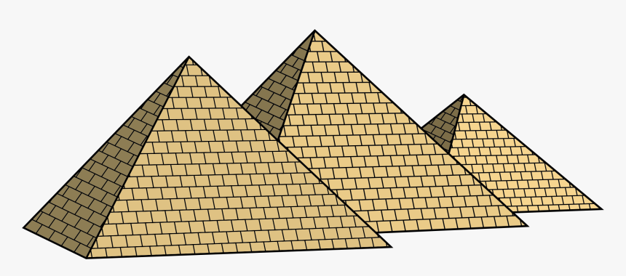
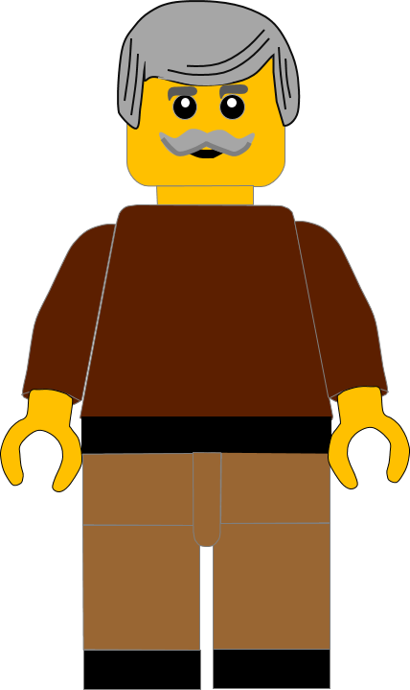
In this activity you will be given 10 questions about the story of Moses and the 10th commandment which you can find in Exodus 20 v17.
You will be given 3 possible answers to each question and you have to choose the right one.
Click here to start the quiz

Slide 3
Question 1:
What did the 8th commandment tell us not do?
Murder
Lie
Steal
Press your answer

Slide 4
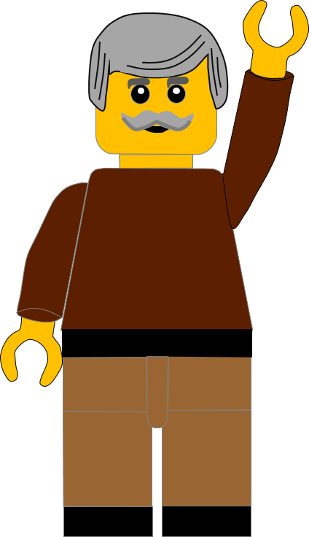
Question 1:
What did the 8th commandment tell us not do?
Murder
Lie
Steal
You are right.
The 8th commandment tells us not to STEAL.
Well Done
Click for the next question

Slide 5
Question 2:
When God gave Moses the Ten Commandments where was Moses?
In the desert
On Mount Sinai
In the temple
Press your answer

Slide 6
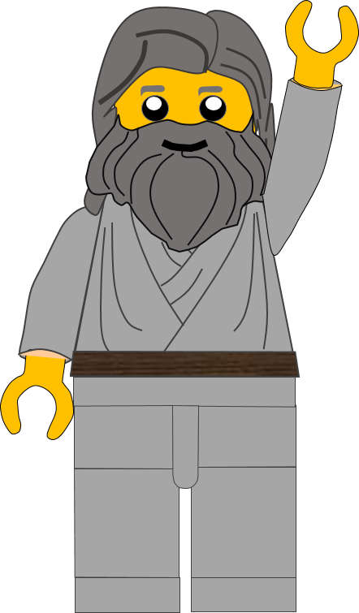
Question 2:
When God gave Moses the Ten Commandments where was Moses?
In the desert
On Mount Sinai
In the temple
That’s the right answer.
God gave Moses the Commandments on
MOUNT SINAI
Great answer
Click for the next question

Slide 7
Question 3:
The 10th commandment tells us that we must not _ _ _ _ other people’s things ?
Want
Love
Hate
Press your answer

Slide 8
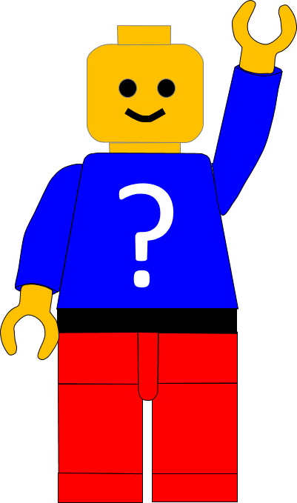
Question 3:
The 10th commandment tells us that we must not _ _ _ _ other people’s things ?
Want
Love
Hate
That’s correct.
The commandment tells us not to WANT other people’s things
Well Done
Click for the next question

Slide 9
Question 4:
What is the old-fashioned word that means to want other people’s things?
Covet
Cover
Coves
Press your answer

Slide 10
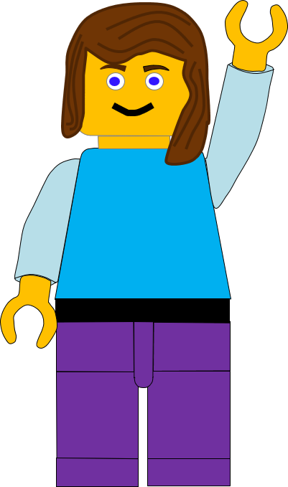
Question 4:
What is the old-fashioned word that means to want other people’s things?
Covet
Cover
Coves
The word COVET means to want someone’s things.
Well Done
Click for the next question

Slide 11
Question 5:
What word describes how we feel when we want someone else’s things?
Jagged
Joyful
Jealous
Press your answer

Slide 12
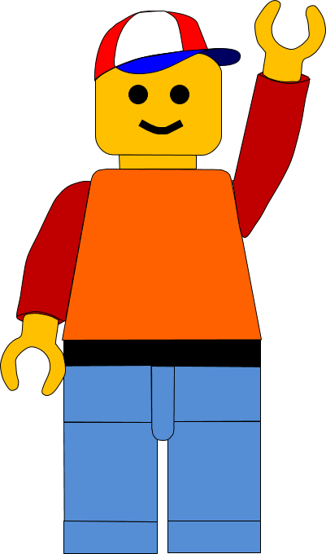
Question 5:
What word describes how we feel when we want someone else’s things?
Jagged
Joyful
Jealous
Great answer.
When we want someone’s things, we are JEALOUS of them.
Well Done
Click for the next question

Slide 13
Question 6:
Who can it hurt when we are JEALOUS of someone?
Us
The other person
God
Press your answer

Slide 14
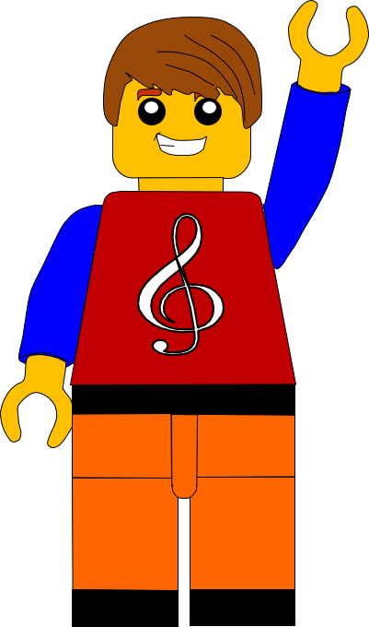
Question 6:
Who can it hurt when we are JEALOUS of someone?
Us
The other person
God
Great answer.
Being jealous can hurt everyone; us, the other Person and God.
Well Done
Click for the next question

Slide 15
Question 7:
What did Jesus say we should do to our neighbour?
Ignore them
Love them
Hate them
Press your answer

Slide 16
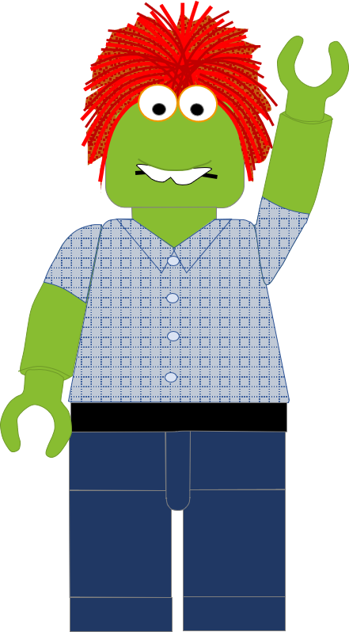
Question 7:
What did Jesus say we should do to our neighbour?
Ignore them
Love them
Hate them
You’re right.
Jesus said, we should LOVE our neighbours like ourselves.
Well Done
Click for the next question

Slide 17
Question 8:
What part of the body did Jesus say we should love God with?
Heart
Head
Hand
Press your answer

Slide 18
Question 8:
What part of the body did Jesus say we should love God with?
Heart
Head
Hand
That’s right.
Jesus said we should love God with all our HEART.
Well Done
Click for the next question

Slide 19
Question 9:
What other part of the body did Jesus say we should love God with?
The Legs
The Arms
The Mind
Press your answer

Slide 20
Question 9:
What other part of the body did Jesus say we should love God with?
The Legs
The Arms
The Mind
That’s right.
Jesus said we should love God with all our MIND.
Well Done
Click for the next question

Slide 21
Question 10:
In Matthew 22 who did Jesus say we should love?
Our Neighbour
Our Football team
Our Friends
Press your answer

Slide 22
Question 10:
In Matthew 22 who did Jesus say we should love?
Our Neighbour
Our Football team
Our Friends
Correct answer.
Jesus said we should love our NEIGHBOUR as ourselves.
Well Done
Click for the next question

Slide 23
Well done for finishing the quiz.
I’ll have another one for you next week.
See you next time

Slide 24
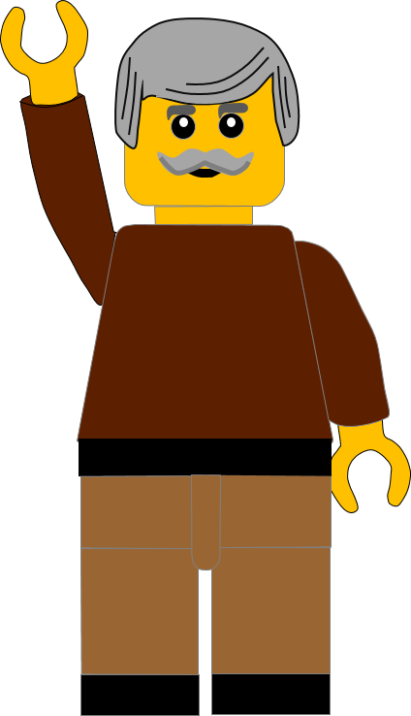
Whoops!
That’s not quite right.
Try again.
Click to return to the quiz

