Slide 1
Please click on the “slide show” tab on the top bar and “From Beginning” tab to start the Activity

Slide 2
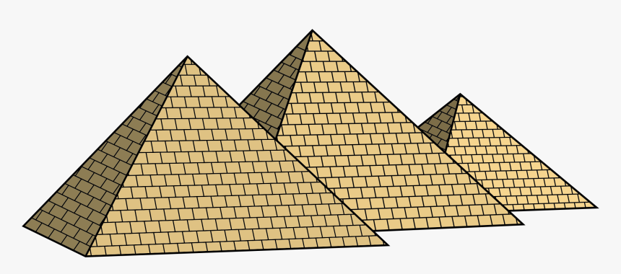
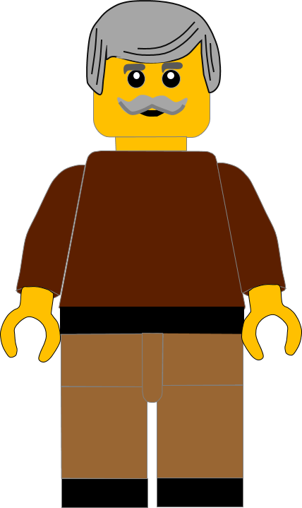
In this activity you will be given 10 questions about the story of Moses and the 6th commandment which you can find in Exodus 20 v13.
You will be given 3 possible answers to each question and you have to choose the right one.
Click here to start the quiz

Slide 3
Question 1:
God gave Moses the Ten Commandments, so the Israelites would know how to . . . ?
Live
Do wrong
Have fun
Press your answer

Slide 4
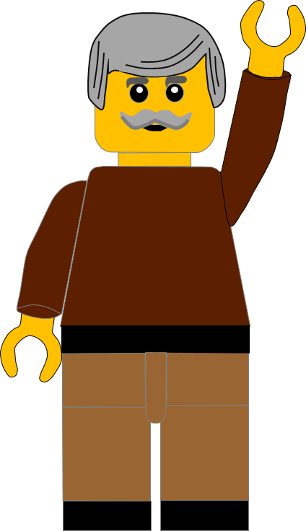
Question 1:
God gave Moses the Ten Commandments, so the Israelites would know how to . . . ?
Live
Do wrong
Have fun
You are right.
God gave the commandments so the people would know how to LIVE correctly.
Well Done
Click for the next question

Slide 5
Question 2:
In the 6th Commandment God tells Moses not to . . . . anyone?
Help
Talk to
Murder
Press your answer

Slide 6
Question 2:
In the 6th Commandment God tells Moses not to . . . . anyone?
Help
Talk to
Murder
That’s correct.
In the 6th commandment God tells Moses not to MURDER anyone.
Well Done
Click for the next question

Slide 7
Question 3:
Murder is another word for
. . . . . . . someone?
Healing
Helping
Killing
Press your answer

Slide 8
Question 3:
Murder is another word for
. . . . . . . someone?
Healing
Helping
Killing
You’re correct.
Murder is another word for KILLING.
Well Done
Click for the next question

Slide 9
Question 4:
When Jesus talked about the 6th Commandment, what did he say was like murder?
Anger
Animals
Angels
Press your answer

Slide 10
Question 4:
When Jesus talked about the 6th Commandment, what did he say was like murder?
Anger
Animals
Angels
Great answer.
Jesus said that being ANGRY would be judged like murder.
Well Done
Click for the next question

Slide 11
Question 5:
Jesus said that when you
say . . . . . things about your brother you will be judged?
Nice
Bad
Good
Press your answer

Slide 12
Question 5:
Jesus said that when you
say . . . . . things about your brother you will be judged?
Nice
Bad
Good
Correct answer.
Jesus said that when you say BAD things about your brother you will be judged.
Well Done
Click for the next question

Slide 13
Question 6:
What did Jesus say
would put us in danger?
Crossing the road
Calling names
Cooking dinner
Press your answer

Slide 14
Question 6:
What did Jesus say
would put us in danger?
Crossing the road
Calling names
Cooking dinner
That’s right.
Jesus said CALLING NAMES would put us in danger.
Well Done
Click for the next question

Slide 15
Question 7:
What name did Jesus say
was wrong to call someone?
Frog
Friend
Fool
Press your answer

Slide 16
Question 7:
What name did Jesus say
was wrong to call someone?
Frog
Friend
Fool
Right answer.
Jesus said we shouldn’t call someone a FOOL.
Well Done
Click for the next question

Slide 17
Question 8:
Jesus didn’t mean that the word was bad. It is the way we say the words.
Which is the wrong way?
Hatefully
Happily
Hopefully
Press your answer

Slide 18
Question 8:
Jesus didn’t mean that the word was bad. It is the way we say the words.
Which is the wrong way?
Hatefully
Happily
Hopefully
Good answer.
If we say things
HATEFULLY or HARMFULLY it doesn’t please God.
Well Done
Click for the next question

Slide 19
Question 9:
What is a much better way to speak to people?
Sneakily
Nastily
Kindly
Press your answer

Slide 20
Question 9:
What is a much better way to speak to people?
Sneakily
Nastily
Kindly
You’re right.
We should speak KINDLY to other people.
Well Done
Click for the next question

Slide 21
Question 10:
What is another good way we should speak to people?
Crossly
Helpfully
Grumpily
Press your answer

Slide 22
Question 10:
What is another good way we should speak to people?
Crossly
Helpfully
Grumpily
I think you’re right.
We should speak HELPFULLY to other people.
Well Done
Click for the next question

Slide 23
Well done for finishing the quiz.
I’ll have another one for you next week.
See you next time

Slide 24
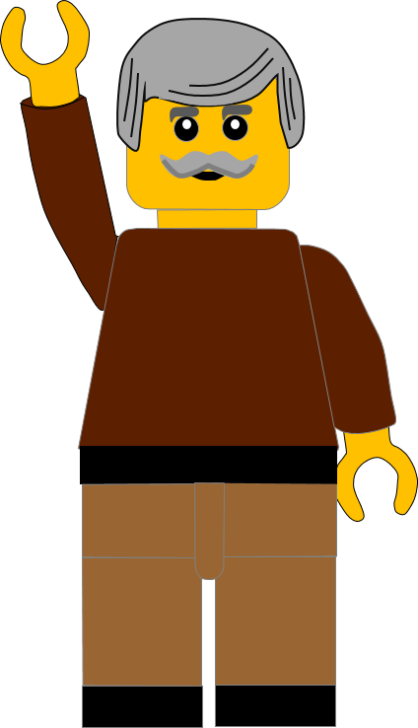
Whoops!
That’s not quite right.
Try again.
Click to return to the quiz

