Slide 1
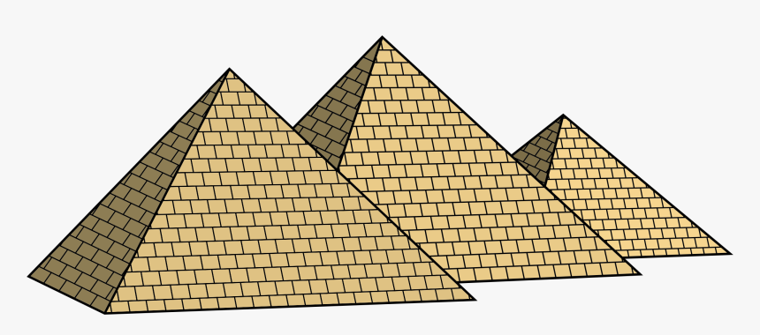
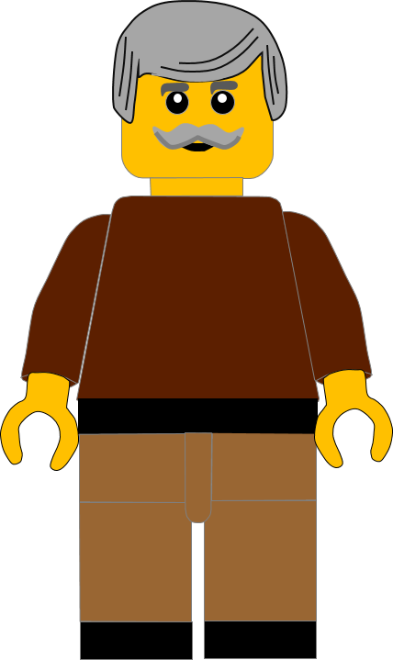
In this activity you will be given 10 questions about the story of Moses and the Burning Bush, which you can find in Exodus 3v1 – 4v23.
You will be given 3 possible answers to each question and you have to choose the right one.
Click here to start the quiz

Slide 2
Question 1:
Moses was looking after some . . .?
Camels
Cows
Sheep
Press your answer

Slide 3
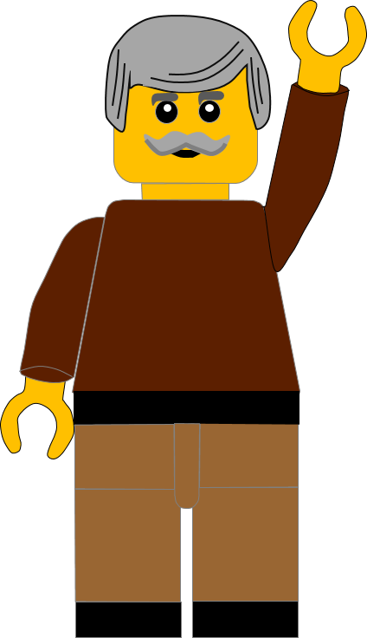
Question 1:
Moses was looking after some . . .?
Camels
Cows
Sheep
You are right.
Moses was looking after some sheep.
Well Done
Click for the next question

Slide 4
Question 2:
Where was Moses looking after the sheep?
In the Desert
In the Fields
On the Farm
Press your answer

Slide 5
Question 2:
Where was Moses looking after the sheep?
In the Desert
In the Fields
On the Farm
You are right.
Moses was looking after the sheep in the desert.
Well Done
Click for the next question

Slide 6
Question 3:
What was the name of the mountain that Moses came to?
Snowdon
Sinai
Everest
Press your answer

Slide 7
Question 3:
What was the name of the mountain that Moses came to?
Snowdon
Sinai
Everest
You are right.
Moses came to Mount Sinai.
Well Done
Click for the next question

Slide 8
Question 4:
What did Moses see on the mountain?
Burning Bush
Shining Fountain
Glowing Crystal
Press your answer

Slide 9
Question 4:
What was the Egyptian doing?
Burning Bush
Shining Fountain
Glowing Crystal
You are right.
Moses saw a Burning Bush but it wasn’t burnt up.
Well Done
Click for the next question

Slide 10
Question 5:
What was the first thing God said to Moses from the Burning Bush?
Go Back
Moses, Moses
Come Closer
Press your answer

Slide 11
Question 5:
What was the first thing God said to Moses from the burning Bush?
Go Back
Moses, Moses
Come Closer
You are correct.
The first thing God did was to call Moses by his name.
Well Done
Click for the next question

Slide 12
Question 6:
Which part of Moses’ clothes did God tell Moses to take off?
Sandals
Hat
Coat
Press your answer

Slide 13
Question 6:
Which part of Moses’ clothes did God tell Moses to take off?
Sandals
Hat
Coat
You are right.
God told Moses to take his sandals off.
Well Done
Click for the next question

Slide 14
Question 7:
What did God tell Moses to do?
Go back to Jethro
Go back to Midian
Go back to Pharaoh
Press your answer

Slide 15
Question 7:
What did God tell Moses to do?
Go back to Jethro
Go back to Midian
Go back to Pharaoh
You are right.
God told Moses to go back to speak to Pharaoh
Well Done
Click for the next question

Slide 16
Question 8:
Which of these excuses did Moses make to God?
Pharaoh will put me in prison
The people won’t believe me
The people will chase me away
Press your answer

Slide 17
Question 8:
Which of these excuses did Moses make to God?
Pharaoh will put me in prison
The people won’t believe me
The people will chase me away
You are right.
Moses said the people wouldn’t believe God had sent him.
Well Done
Click for the next question

Slide 18
Question 9:
What sign did God give Moses to show to the people?
Rock changed to Gold
Water changed to Wine
Stick changed to Snake
Press your answer

Slide 19
Question 9:
What sign did God give Moses to show to the people?
Rock changed to Gold
Water changed to Wine
Stick changed to Snake
You are right.
When Moses threw the stick on the ground it changed into a snake.
Well Done
Click for the next question

Slide 20
Question 10:
Who did God say would speak for Moses?
Zipporah
Aaron
Jethro
Press your answer

Slide 21
Question 10:
Who did God say would speak for Moses?
Zipporah
Aaron
Jethro
You are right.
God said Aaron, Moses’ brother would speak for him.
Well Done
Click for the next slide

Slide 22
Well done for finishing the quiz.
I’ll have another one for you next week.
See you next time

Slide 23
Whoops!
That’s not quite right.
Try again.
Click to return to the quiz

