Slide 1
Please click on the “slide show” tab on the top bar and “From Beginning” tab to start the Activity

Slide 2
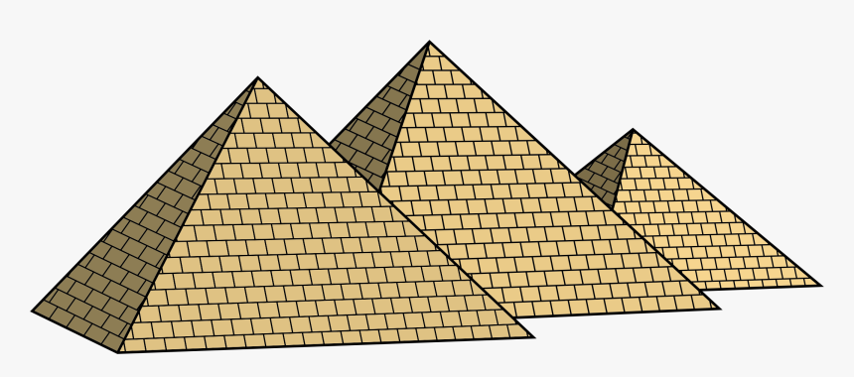
In this activity you will be given 10 questions about the story of Moses and the Passover, which you can find in Exodus 12v1 – 13.
You will be given 3 possible answers to each question and you have to choose the right one.
Click here to start the quiz

Slide 3
Question 1:
How many plagues did God send on Egypt before Pharaoh listened?
Eight
Nine
Ten
Press your answer

Slide 4
Question 1:
How many plagues did God send on Egypt before Pharaoh listened?
Eight
Nine
Ten
You are right.
God sent 10 plagues on Egypt.
Well Done
Click for the next question

Slide 5
Question 2:
What type of animal did God tell the Israelites to sacrifice?
Lamb
Chicken
Pig
Press your answer

Slide 6
Question 2:
What type of animal did God tell the Israelites to sacrifice?
Lamb
Chicken
Pig
You are right.
God told the Israelites to sacrifice a lamb.
Well Done
Click for the next question

Slide 7
Question 3:
How old did God say the lamb should be?
6months
1 Year
2 Years
Press your answer

Slide 8
Question 3:
How old did God say the lamb should be?
6months
1 Year
2 Years
You are right.
The lamb was to be a 1 year old perfect lamb .
Well Done
Click for the next question

Slide 9
Question 4:
How was the lamb to be cooked?
Roasted
Boiled
Fried
Press your answer

Slide 10
Question 4:
How was the lamb to be cooked?
Roasted
Boiled
Fried
You are right.
God said that the lamb had to be roasted.
Well Done
Click for the next question

Slide 11
Question 5:
What was eaten with the roast lamb?
Roast Potatoes
Bitter Herbs
Mushy Peas
Press your answer

Slide 12
Question 5:
What was eaten with the roast lamb?
Roast Potatoes
Bitter Herbs
Mushy Peas
You are correct.
The Israelites were told to eat Bitter Herbs with the lamb
Well Done
Click for the next question

Slide 13
Question 6:
What ingredient was left out of the bread?
Yeast
Salt
Butter
Press your answer

Slide 14
Question 6:
What ingredient was left out of the bread?
Yeast
Salt
Butter
You are right.
God said to leave out the yeast from the bread.
Well Done
Click for the next question

Slide 15
Question 7:
What did God tell the Israelites to do with any leftover lamb?
Give it to the dogs
Throw it away
Burn it
Press your answer

Slide 16
Question 7:
What did God tell the Israelites to do with any leftover lamb?
Give it to the dogs
Throw it away
Burn it
You are right.
God told the Israelites to burn any leftover lamb.
Well Done
Click for the next question

Slide 17
Question 8:
What did God tell the Israelites to do with the Lamb’s blood?
Put it on the fire
Put it on the door frames
Put it on the house roof
Press your answer

Slide 18
Question 8:
What did God tell the Israelites to do with the Lamb’s blood?
Put it on the fire
Put it on the door frames
Put it on the house roof
You are right.
God told the people to put the blood on the door frames.
Well Done
Click for the next question

Slide 19
Question 9:
Why did the people put the blood on the door frames?
The houses needed painting
To please Pharaoh
So God would pass over the house
Press your answer

Slide 20
Question 9:
Why did the people put the blood on the door frames?
The houses needed painting
To please Pharaoh
So God would pass over the house
You are right.
God promised to pass over the house if the Israelites obeyed Him.
Well Done
Click for the next question

Slide 21
Question 10:
What happened to the houses that didn’t have blood on the door frame?
The owner ran away
The firstborn son died
The house fell down
Press your answer

Slide 22
Question 10:
What happened to the houses that didn’t have blood on the door frame?
The owner ran away
The firstborn son died
The house fell down
You are right.
The firstborn son died in the houses that didn’t obey God.
Well Done
Click for the next slide

Slide 23
Well done for finishing the quiz.
I’ll have another one for you next week.
See you next time

Slide 24
Whoops!
That’s not quite right.
Try again.
Click to return to the quiz

