Slide 1
Please click on the “slide show” tab on the top bar and “From Beginning” tab to start the Activity

Slide 2
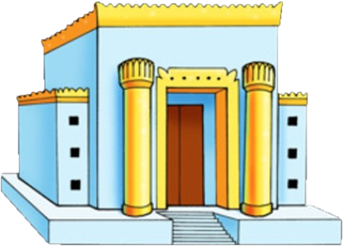
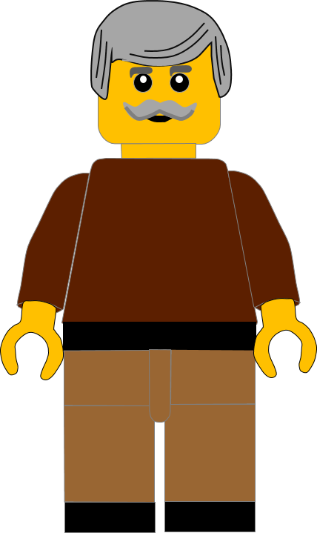
In this activity you will be given 10 questions about the stories of Jesus visiting the temple in
Luke chapter 2 v 21 -51.
You will be given 3 possible answers to each question and you have to choose the right one.
Click here to start the quiz

Slide 3
Question 1:
Who took the baby Jesus to the temple?
Mary
Martha
Miriam
Press your answer

Slide 4
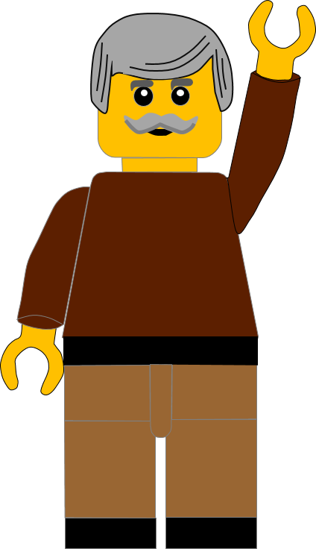
Question 1:
Who took the baby Jesus to the temple?
Mary
Martha
Miriam
You are right.
MARY and Joseph took the baby Jesus to the temple.
Well Done
Click for the next question

Slide 5
Question 2:
Which city was the temple in?
Jericho
Jerusalem
Nazareth
Press your answer

Slide 6
Question 2:
Which city was the temple in?
Jericho
Jerusalem
Nazareth
You are correct.
The temple was in JERUSALEM.
Well Done
Click for the next question

Slide 7
Question 3:
What old man had been waiting for God’s Messiah?
Samson
Samuel
Simeon
Press your answer

Slide 8
Question 3:
What old man had been waiting for God’s Messiah?
Samson
Samuel
Simeon
Fantastic answer.
SIMEON,had been waiting for God’s Messiah.
Well Done
Click for the next question

Slide 9
Question 4:
What was the name of the prophetess waiting in the temple?
Alice
Anna
Angela
Press your answer

Slide 10
Question 4:
What was the name of the prophetess waiting in the temple?
Alice
Anna
Angela
Great answer.
ANNA was the prophetess waiting in the temple..
Well Done
Click for the next question

Slide 11
Question 5:
What bird could Mary and Joseph sacrifice to say thank you to God for Jesus?
Chicken
Sparrow
Dove
Press your answer

Slide 12
Question 5:
What bird could Mary and Joseph sacrifice to say thank you to God for Jesus?
Chicken
Sparrow
Dove
You are correct.
Mary and Joseph could sacrifice 2 DOVEs or 2 pigeons as a thank you to God.
Well Done
Click for the next question

Slide 13
Question 6:
Why did Mary and Joseph go to the temple every year?
Passover
Christmas
Birthdays
Press your answer

Slide 14
Question 6:
Why did Mary and Joseph go to the temple every year?
Passover
Christmas
Birthdays
You are right.
Mary and Joseph went to celebrate the feast of PASSOVER.
Well Done
Click for the next question

Slide 15
Question 7:
How old was Jesus in this part of the story?
12 years old
10 years old
8 years old
Press your answer

Slide 16
Question 7:
How old was Jesus in this part of the story?
12 years old
10 years old
8 years old
Spot on answer.
Jesus was 12 YEARS OLD in the story.
Well Done
Click for the next question

Slide 17
Question 8:
Where were Mary and Joseph going to, when they discovered that Jesus was missing?
Jerusalem
Nazareth
Bethlehem
Press your answer

Slide 18
Question 8:
Where were Mary and Joseph going to, when they discovered that Jesus was missing?
Jerusalem
Nazareth
Bethlehem
Great answer.
Mary and Joseph were going home to NAZARETH.
Well Done
Click for the next question

Slide 19
Question 9:
How long did Mary and Joseph search for Jesus before they found him?
2 days
3 days
4 days
Press your answer

Slide 20
Question 9:
How long did Mary and Joseph search for Jesus before they found him?
2 days
3 days
4 days
Fantastic answer.
Mary and Joseph searched for 3 DAYS before they found Jesus .
Well Done
Click for the next question

Slide 21
Question 10:
Who was Jesus talking to in the temple?
Teachers
Romans
Servants
Press your answer

Slide 22
Question 10:
Who was Jesus talking to in the temple?
Teachers
Romans
Servants
That’s the right answer.
Jesus was talking with the religious TEACHERS in the temple.
Well Done
Click for the next question

Slide 23
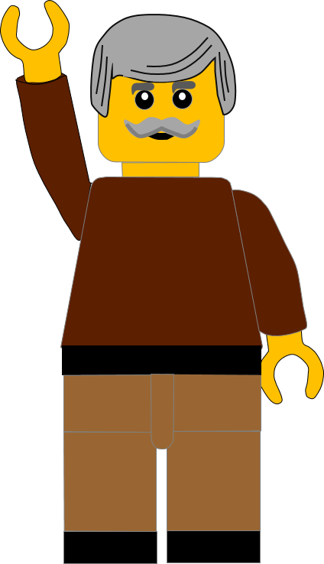
Well done for finishing the quiz.
I’ll have another one for you next week.
See you next time

Slide 24
Whoops!
That’s not quite right.
Try again.
Click to return to the quiz

